Slide 1
EASTER IN BRITAIN

Slide 2
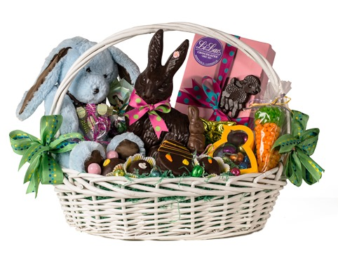
They set up an Easter basket.

Slide 3
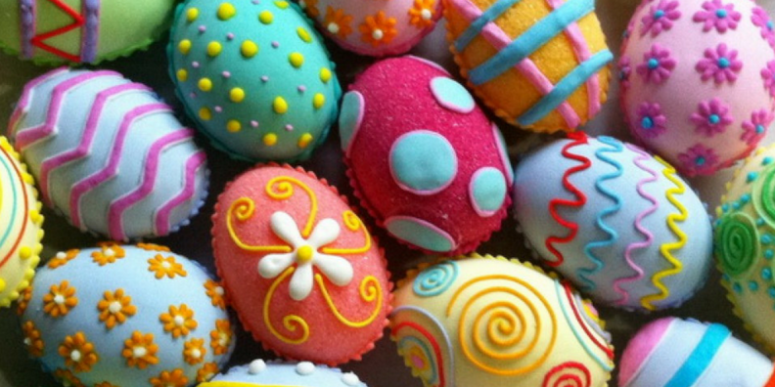
They decorate Easter eggs.

Slide 4
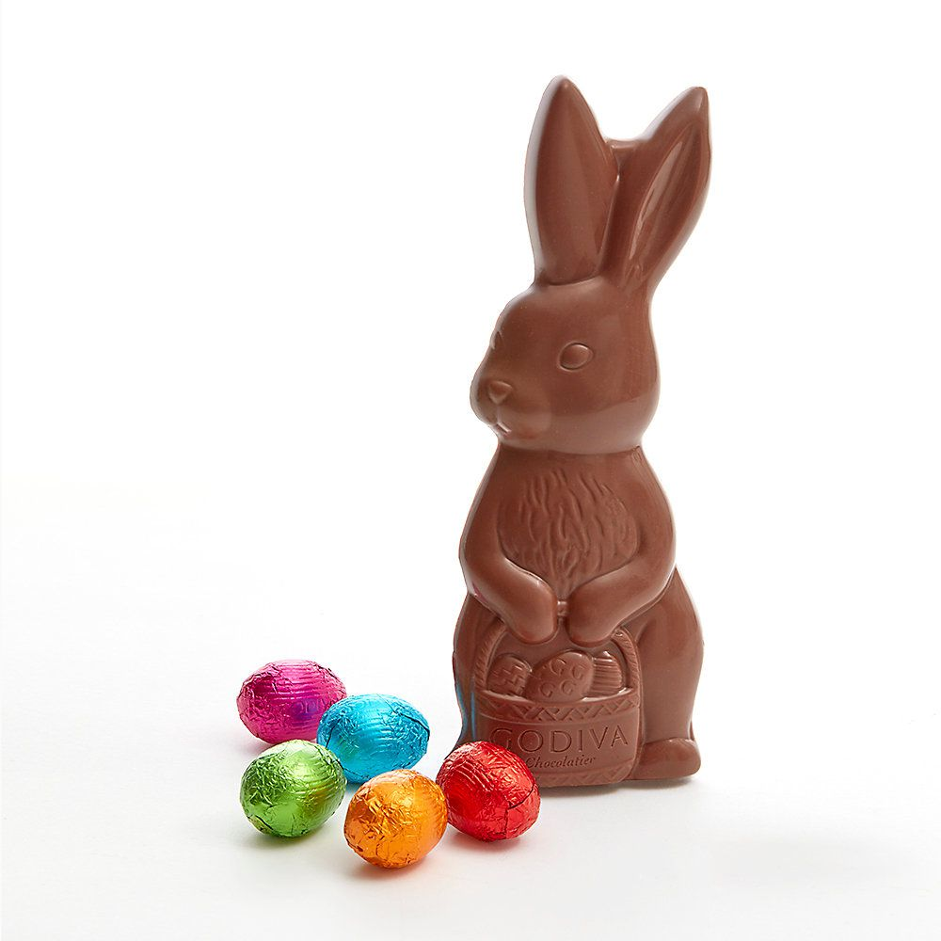
Everyone loves a chocholate Easter bunny! ☺

Slide 5
They have Easter holidays. This year, they are at home the same as we are.

Slide 6
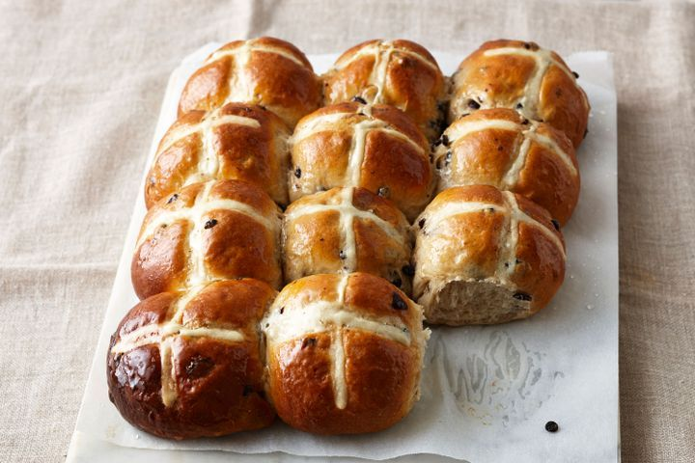
Hot cross buns are a traditional food in Great Britain.

Slide 7
Easter Sunday was on 21st April last year. In 2020, it‘s on 12th April.

Slide 8
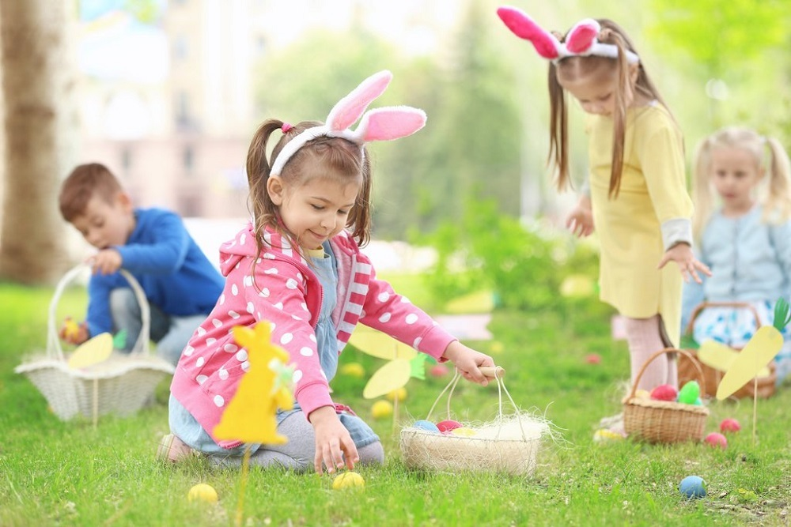
Parents hide eggs for Easter egg hunt. Children look for eggs.

Slide 9
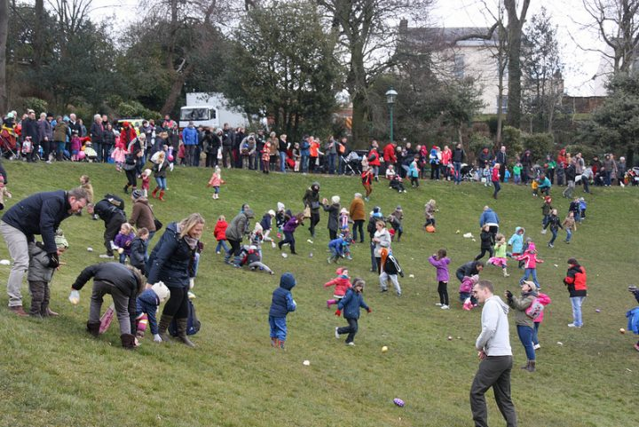
In Great Britain, they go egg-rolling for Easter.

